Slide 1
Using spsurvey to Create Aquatic Spatial Survey Designs
Anthony (Tony) R. Olsen
Western Ecology Division
US Environmental Protection Agency
Corvallis, Oregon
Olsen.Tony@epa.gov
http://www.epa.gov/nheerl/arm

Slide 2
Spatial Survey Design Process
Site
Selection
using R
Design
File
Resource
Characteristics
Target
Population
Spatial
Survey
Design
Monitoring
Objectives
Design
Requirements
Institutional
Constraints
Sample
Frame
Notes:
Spatial survey design process involves three interrelated steps: (1) specifying the design requirements based on monitoring objectives, resource characteristics, target population, sample frame and institutional constraints, (2) selecting a spatial survey design that accomplishes the design requirements, and (3) selecting the sites based on the spatial survey design and the sample frame to produce the design file.

Slide 3
Spatial Survey Design Options: GRTS or IRS site selection
Three sample frame types (shapefile types)
Point or finite
Linear network
Area or polygon
Survey Design features
Stratification
Equal, unequal, or continuous probability of selection
Panels for surveys over time
Over sample for use when some sites can not be used
Two stage survey designs

Slide 4
Site Selection using spsurvey Process
Input requirements
Shapefile from which sites (spatial units) will be selected
Spatial survey design based on the design requirements
Specify survey design in R
Select sites using “grts” or “irs” functions in spsurvey
Output options
Shapefile of selected spatial units
Spreadsheet compatible file of selected spatial units
Notes:
Note: Do not need to use a shapefile. Can create an sp object in R instead that has the same information:

Slide 5
Specifying Designs in R
design1 = list(None=list(panel=c(Panel_1=50),
seltype= “Equal”) )
design2 = list(None=list(panel=c(Panel_1=50, Panel_2=50),
seltype= “Equal”,
over=100) )
design3 = list(Stratum1=list(panel=c(Panel_1=50),
seltype= “Equal”
over=50)
Stratum2=list(panel=c(Panel_1=50),
seltype= “Unequal”
caty.n=c(category1=25, category2=25) ) )
Notes:
design1 – Sample size of 50 that is spatially balanced. No stratification. All sites have equal probability of being selected. No over sample sites.
design2 – Total sample size of 200. Two panels of 50 sites each (Panel_1 to be visited in year 1 and Panel_2 to be visited in year 2). No stratification. All sites have equal probability of being selected. An over sample of 100 sites.
design3 - Two strata, “Stratum1” and “Stratum2”. Sample size of 50 in each stratum. “Stratum1” is an equal probability sample of 50 sites with an over sample of 50 sites. “Stratum2” is an unequal probability of selection by two categories named “category1” and “category2” with expected sample size of 25 sites in each category. No over sample sites. Single Panel.

Slide 6
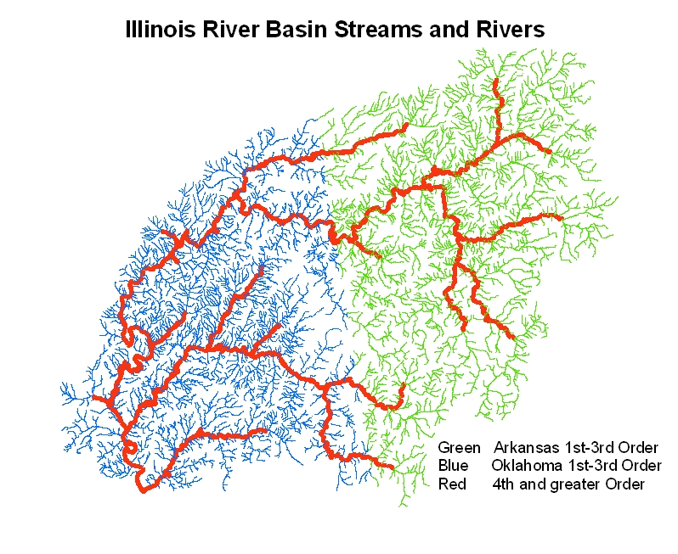

Slide 7
Illinois River Basin GRTS designs for Streams
dsgn <- list(None=list(panel=c(Panel_1=100),
seltype=“Equal” ))
dsgn <- list(Oklahoma=list(panel=c(Panel_1=50),
seltype='Unequal',
caty.n=c(“1st-3rd"=25, “4th-7th”=25),
over=50),
Arkansas=list(panel=c(Panel_1=50),
seltype='Unequal',
caty.n=c (“1st-3rd"=25, “4th-7th”=25),
over=50)
)
Notes:
Two example designs
First design is an equal probability spatially balanced sample of 100 sites from a linear network sample frame.
Second design is stratified by state. In both strata sites are selected with unequal probability using two categories with expected sample size of 25 sites in each: Strahler order streams from 1st thru 3rd and Strahler order streams 4th and greater. An over sample of 50 sites is selected within each strata.

Slide 8
Illinois River Basin Site Selection using R
library(spsurvey)
att <- read.dbf('Illinois_ri_ok_ar')
sites <- grts(design=dsgn,
DesignID="OKI06594",
type.frame="linear",
in.shape="Illinois_ri_ok_ar",
att.frame=att,
stratum="STATE_NAME",
mdcaty="SO_CAT",
prjfilename='Illinois_ri_ok_ar',
out.shape="Illinois River Basin Sites")
Notes:
Read in the dbf file associated with the shapefile for the Illinois River Basin stream network sample frame.
Specify the options to be used by grts to select the sites:
Design – specify the design by giving it the design list of lists object
DesignID – specify a unique character name that will be used to create unique siteID
type.frame – is the sample frame a point, linear, or area (polygon) shapefile
in.shape – name of the shapefile
att.frame – data frame that contains the attributes necessary to specify the survey design
stratum – column name in att.frame that specifies the stratum
mdcaty – column name in att.frame that specifies the unequal probability categories
prjfilename – name of the projection file associated with the shapefile
out.shape – User specified name for the shapefile of the sites selected by grts

Slide 9
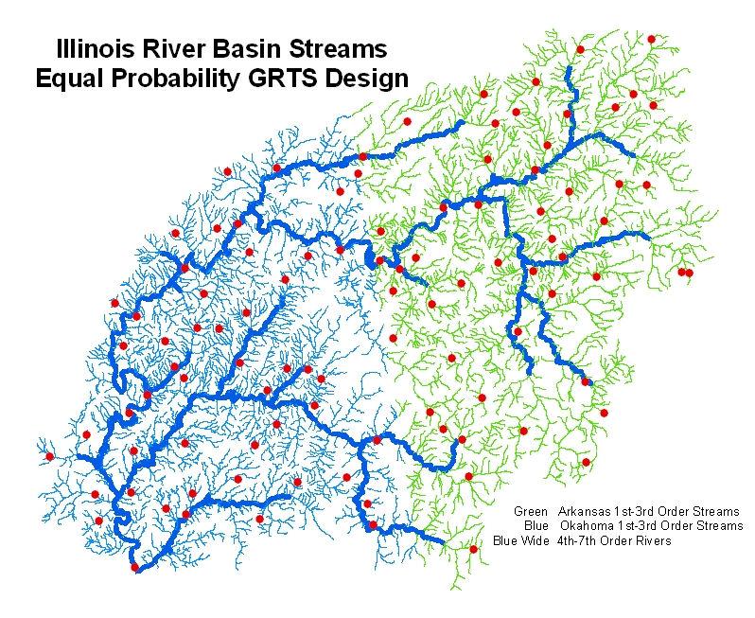
Notes:
Note that most of the sites occur in 1st to 3rd order streams since that is were most of the stream length occurs. Also approximately equal number of sites in Oklahoma and Arkansas since stream length is approximately the same in the states. Don’t have to do anything in the design to accomplish this.

Slide 10
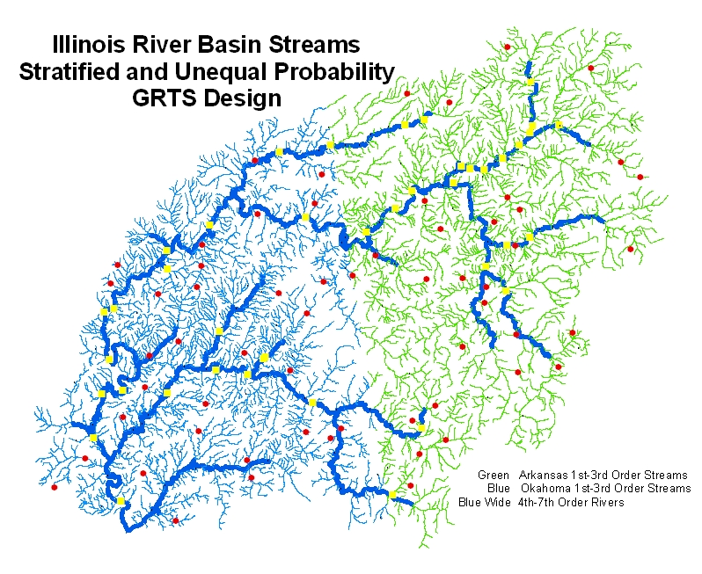
Notes:
Explicitly stratified by state for administrative reason – each state will implement the survey independently.
Unequal probability by two Strahler order categories to meet design requirement of being able to report on small and large streams separately within each state.

Slide 11
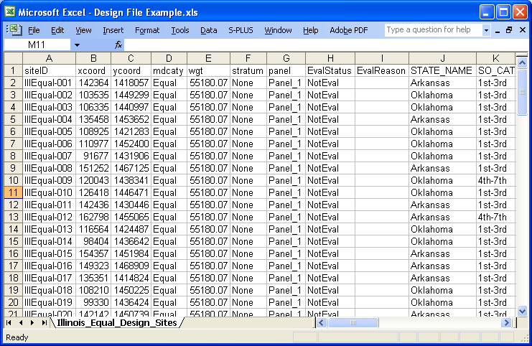
Example Design File
Notes:
siteID – unique site identification. Sites must be used in siteID order. That is, if sample site IllEqual-019, then all sites from IllEqual-001 to IllEqual-019 must be used.
Xcoord, ycoord – x and y coordinate in the projection used.
Mdcaty – names of categorical variables used to do unequal probability sample.
Wgt – weight (in units of map projection) for each site. Must be used in statistical analysis of data
Stratum – identifies stratum that site belongs to.
Panel – identifies which panel in survey over time that site belongs to.
EvalStatus – Column included to record what happened to site during implementation of the design
EvalReason – Column included to give comments about use of the site during implement.
StateName, SO_CAT, … – additional variables that were in the dbf file of the sample frame shapefile.

Slide 12
Use examples to illustrate generation of different spatial survey design requirements and selection of spatial survey designs
Lakes
South Carolina Lakes as area resource
National Lake Assessment lakes as point lake resource
Streams
Illinois River Basin streams as linear stream resource
Pennsylvania attaining stream segments as point stream resource
Estuaries
Puget Sound?
Southern California Bight
Wetlands
Iowa points
Ohio area
Minnesota wetlands as two-stage design

Slide 13
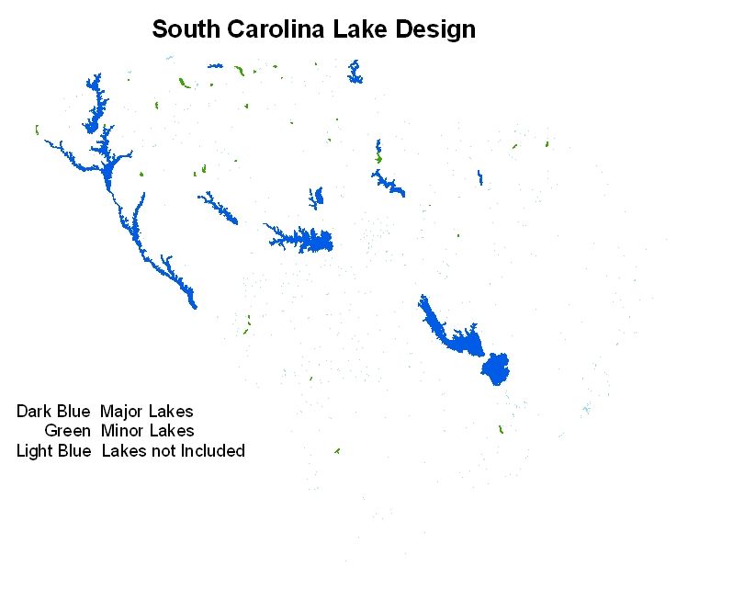

Slide 14
Lake Design: South Carolina
Monitoring Objectives
Estimate the number of hectares of major and minor lakes in South Carolina that meet water quality criteria (also other indicators)
Target Population and Resource Characteristics
State identifies 17 major lakes and 35 minor lakes
Require estimates for major, minor, and combined lake subpopulations
Elements are all possible locations within surface area of identified lakes
Sample Frame
Shapefile from NHD
Attribute that identifies minor, major, and other lakes within state
Institutional Constraints
Sample size 30 sites per year across target population
Complete survey over 5 year period

Slide 15
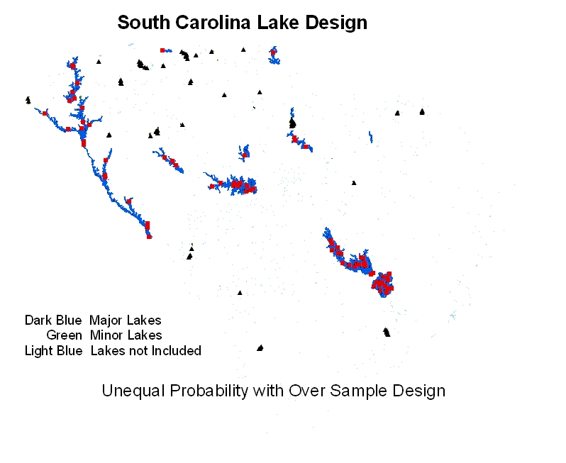

Slide 16
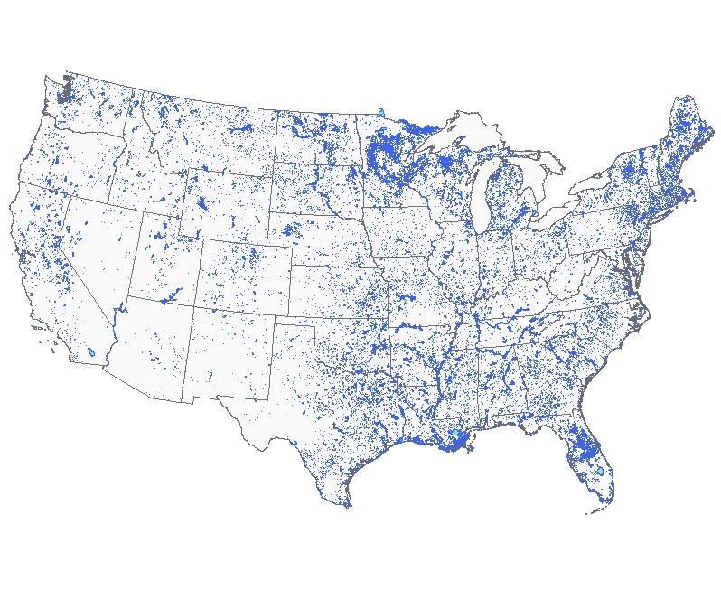
NHD Lakes

Slide 17
Lake Design: National Lake Assessment
Monitoring Objectives
Estimate number of lakes in 48 states that are in “good” condition nationally and by 9 aggregated ecoregions
Estimate change in eutrophication status for 1972-76 National Eutrophication Study lakes
Target Population and Resource Characteristics
All lakes/reservoirs/ponds greater than 4 hectares
Elements are individual lakes
Very skewed lake area size distribution
Sample Frame
Shapefile based on NHD
Attributes for state, lake area category, ecoregion, and NES lake
Institutional Constraints
Total number of lakes that can be sampled: 1000
States operate independently
Survey occur in one year

Slide 18
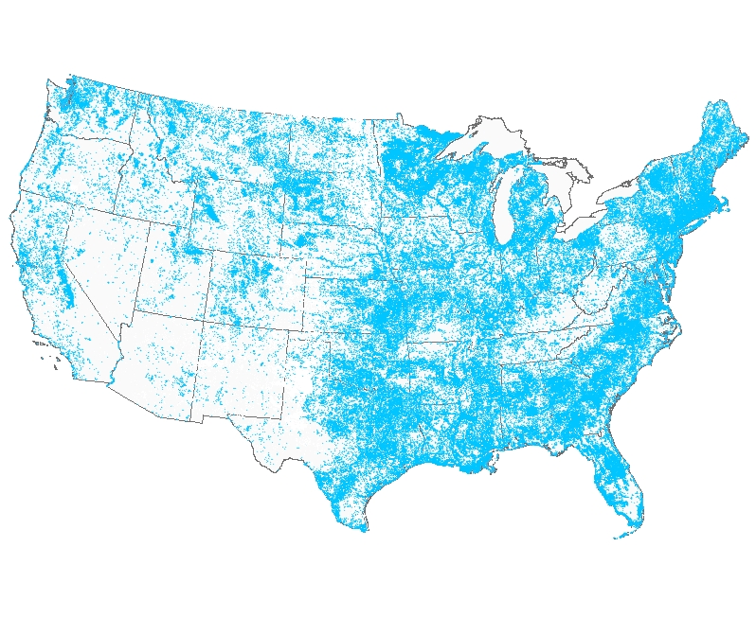
NHD Lake Sample Frame: Points

Slide 19
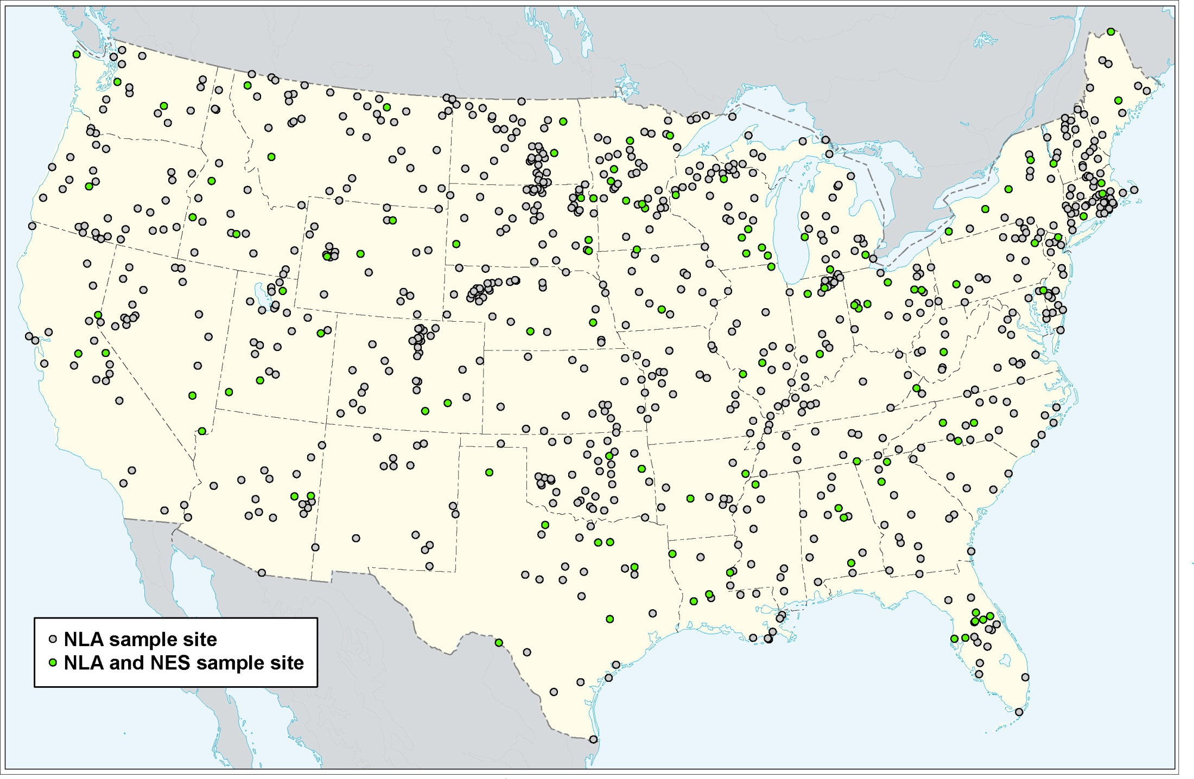

Slide 20
National Lake Survey: Overview
Distribution of Lakes in Survey
Lake Size Category | # of Lakes Selected | Total # of Lakes in the US
10-25 acres | 104 | 68,559
(4-10 hectares)
25-50 acres | 185 | 24,902
(10-20 hectares)
50-125 acres | 184 | 16,488
(20-50 hectares)
125-250 acres | 172 | 6,134
(50-100 hectares)
> 250 acres | 264 | 7,356
(>100 hectares)
Total | 909 | 123,439
Total number of lake visits: 1,000
909 unique lakes
91 lakes for repeat sampling
Number of Lakes from 1972-76 National Lake Eutrophication
Study (NES): 113
Number of Lakes per state:
Range: 4-41
Median: 18
Number of lakes per ecoregion:
Range: 84-119
Median: 101

Slide 21
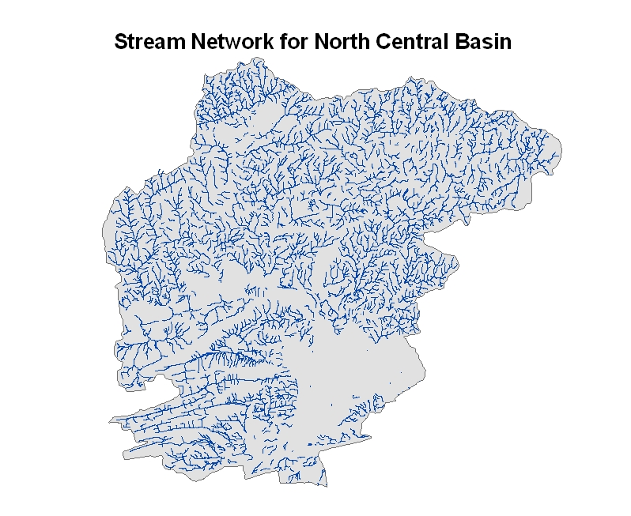

Slide 22
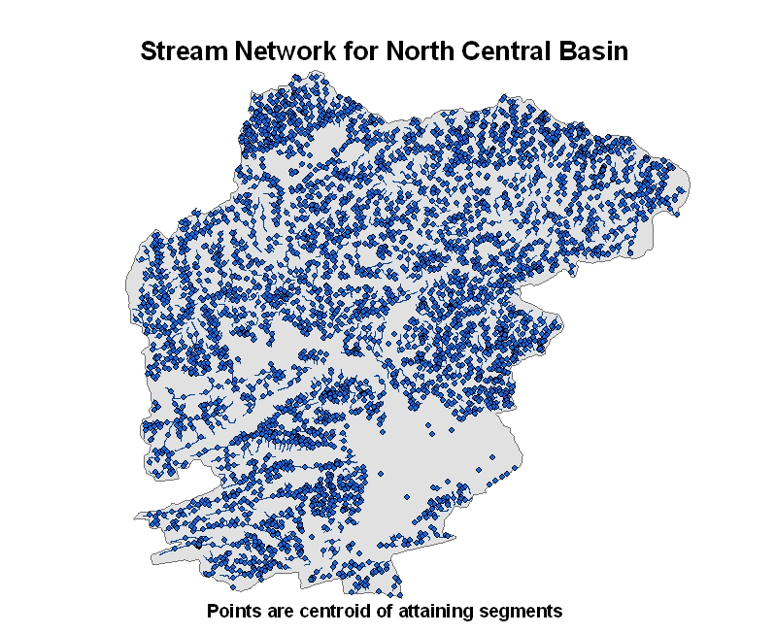

Slide 23
Stream Design: Pennsylvania Attaining Segments
Monitoring Objectives
Estimate number of currently attaining stream segments within each basin that remain attaining
Target Population and Resource Characteristics
All attaining stream segments within each basin in Pennsylvania
Elements are stream segments not point on stream linear network
Sample Frame
Polyline shapefile of stream network and point shapefile of segment centroids
Institutional Constraints
30 segments sampled per basin
5 random locations on each of the 30 segments; one of which will be sampled
Two-stage spatial survey design
Stage 1: select equal probability sample of segments within basin using GRTS for finite/point resource
Stage 2: select sites within each segment using GRTS for linear resource

Slide 24
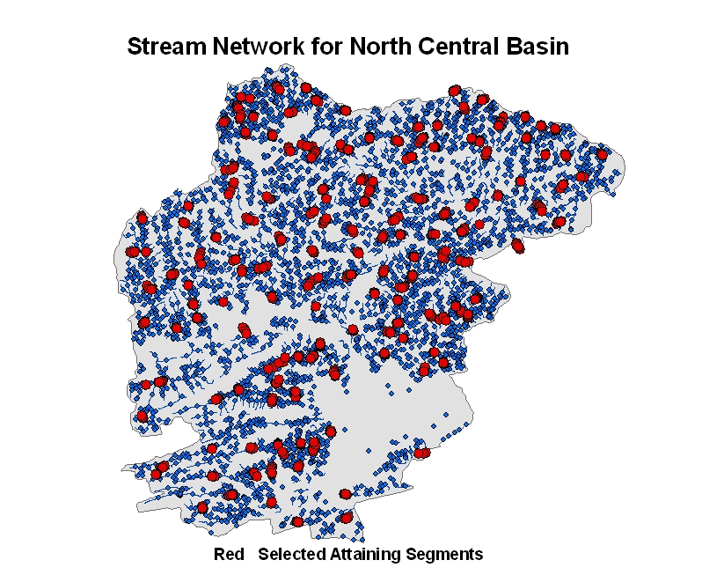

Slide 25
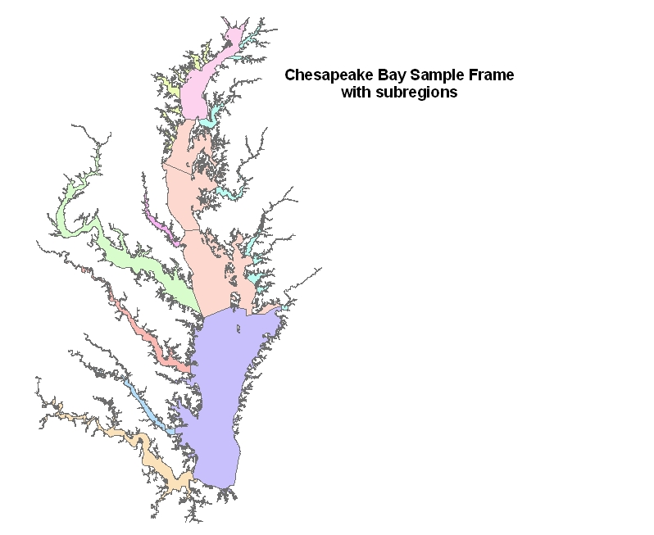

Slide 26
Estuary Design: Chesapeake Bay NCA
Monitoring Objectives
Estimate the square kilometers of Chesapeake Bay and 10 subregions that are in “good” condition
Target Population and Resource Characteristics
Surface area of Chesapeake Bay estuary
Elements are all locations
Subpopulations are 10 subregions
Sample Frame
NCA generated polygon shapefile
Attribute for subregions
Institutional Constraints
125 sites sampled in 2005 and 2006
Spatial survey design for an areal resource with unequal probability for 10 subregions

Slide 27
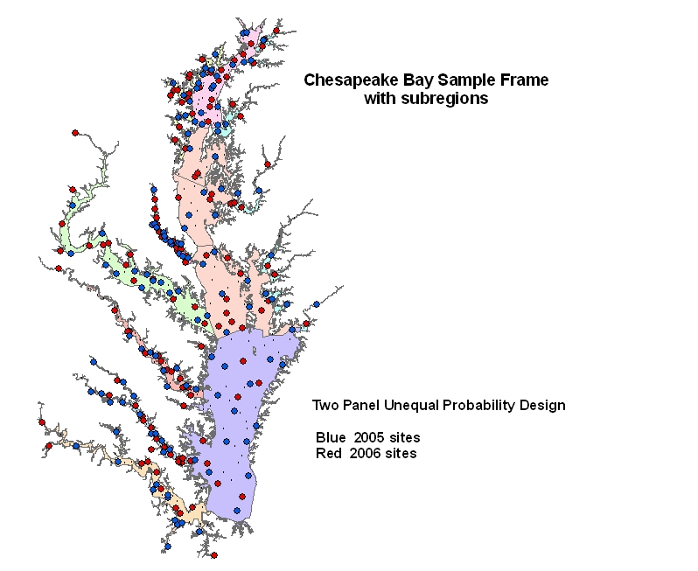

Slide 28
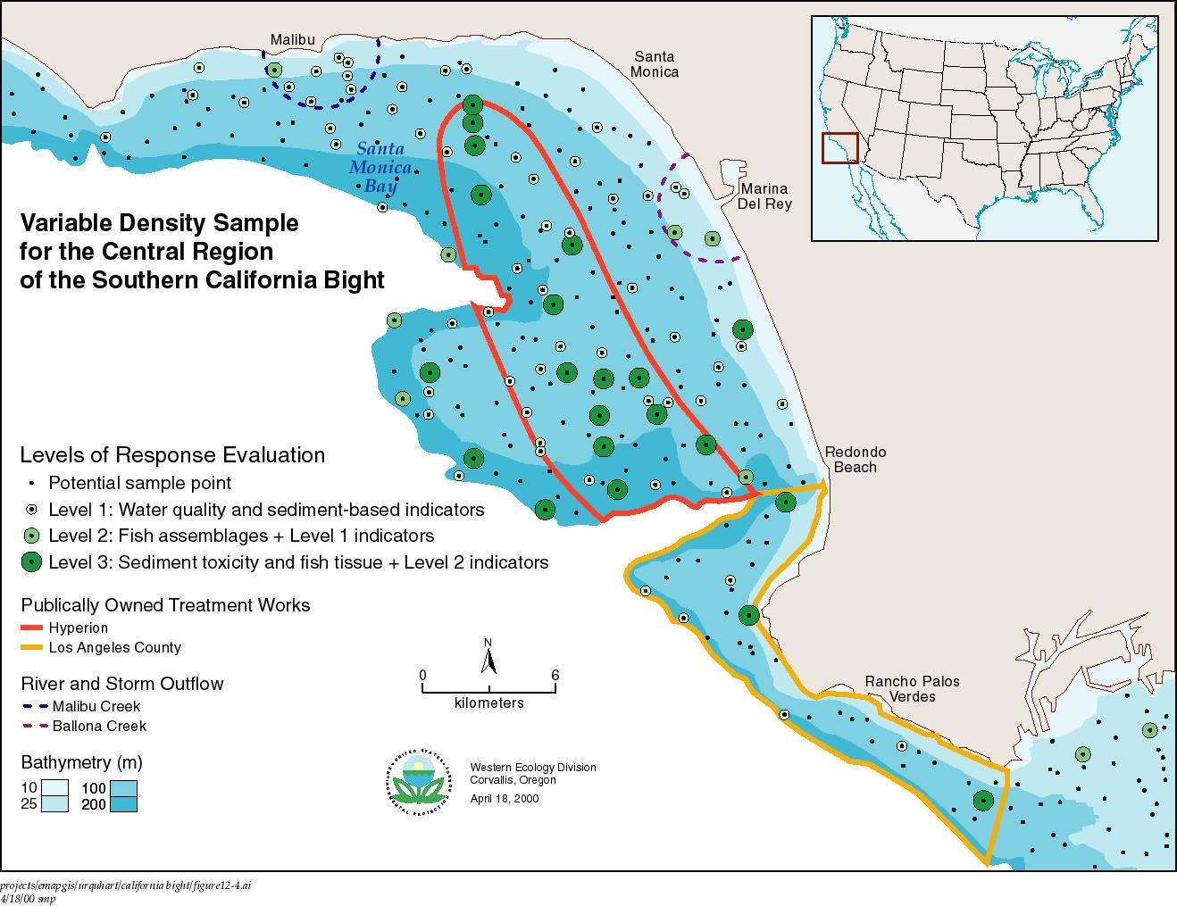
Notes:
Example of a spatially-balanced survey design with (1) unequal probability selection based on overlapping subpopulations that were of interest, and (2) nested subsampling of indicators related to increased cost to acquire some indicators.

Slide 29
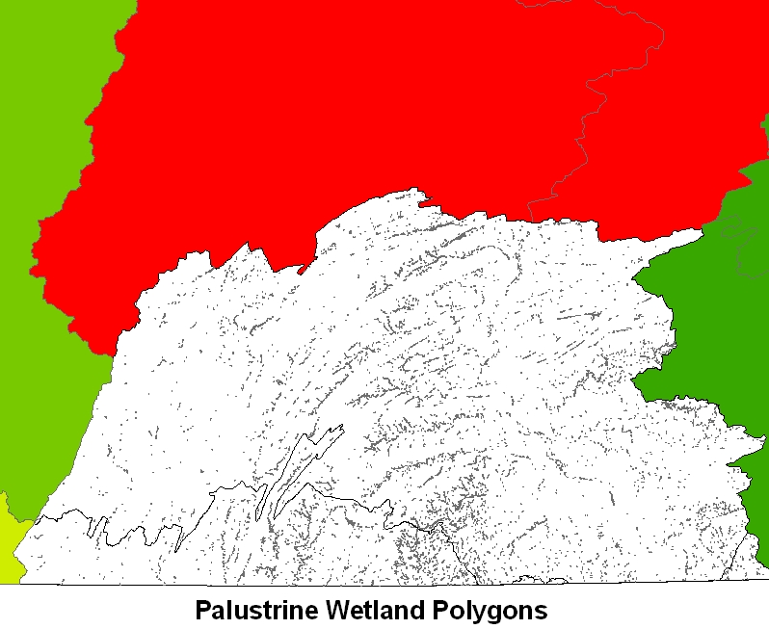

Slide 30
Wetland Design: Pennsylvania
Monitoring Objectives
Estimate number of hectares of palustrine wetlands that are in “good” condition based on a level 2 assessment for each basin in Pennsylvania and for four landcover classes within each basin
Target Population and Resource Characteristics
All mapped NWI vegetated wetlands within the Palustrine Emergent, Palustrine Scrub Shrub and Palustrine Forested classifications that have a predominance (>50%) of emergent, herbaceous or woody vegetation
Elements are all possible locations within the mapped polygons
Sample Frame
NWI polygon shapefile restricted to palustrine classes defined
Attributes added identify 4 landcover classes and reporting basins
Institutional Constraints
Monitoring to be completed over 5 years; each year a basin in each of the six reporting regions of state will be sampled
Expected sample size of 50 in each landcover class in each basin
Over sample of 200% due to sample frame deficiencies
Spatially balanced survey design for an areal resource with unequal probability

Slide 31
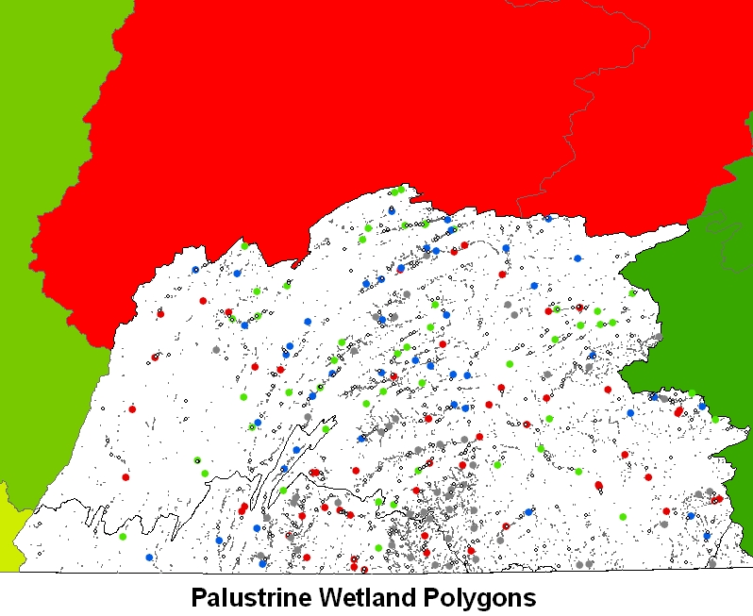

Slide 32
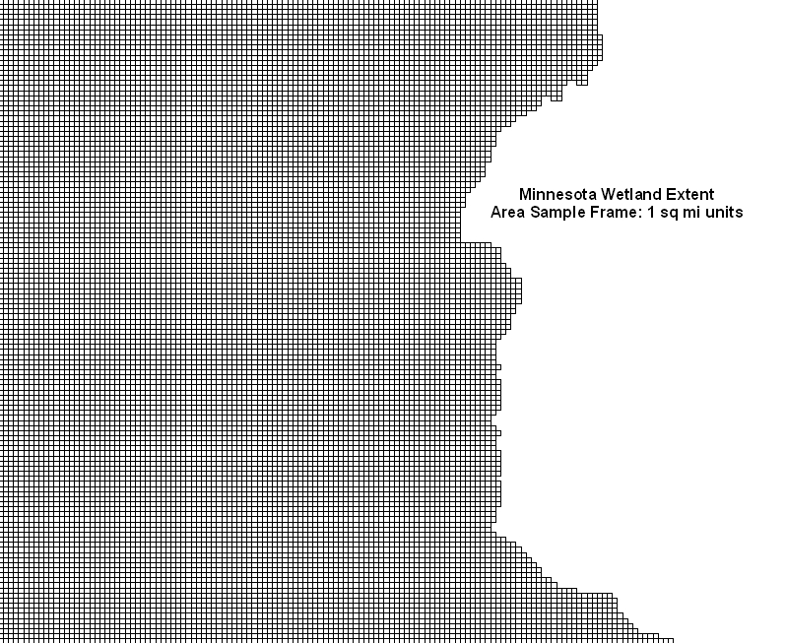

Slide 33
Wetland Design: Minnesota
Monitoring Objectives
Estimate total hectares of wetlands by wetland class and major basin in Minnesota
Estimate number of hectares of depressional wetlands that are in good condition by major basin and state-wide
Target Population and Resource Characteristics
All wetlands that can be identified from aerial photointerpretation using USFWS NWI status and trends mapping procedures
For extent the elements are 1 sq mile pixels that cover Minnesota
For condition the elements are all locations within wetland polygons delineated on aerial photos
Sample Frame
For extent, a point shapefile of centroids of 1 sq mile pixels: an “area frame”
For condition, all wetland polygons within sampled extent pixels
Institutional Constraints
1800 1 sq mile pixels can be photo interpreted each year
Must cover entire state each year
Two stage survey design
Stage 1: Split panel design (annual repeat panel, 3 year panels) equal probability
Stage 2: GRTS design for area resource: remainder to be determined

Slide 34
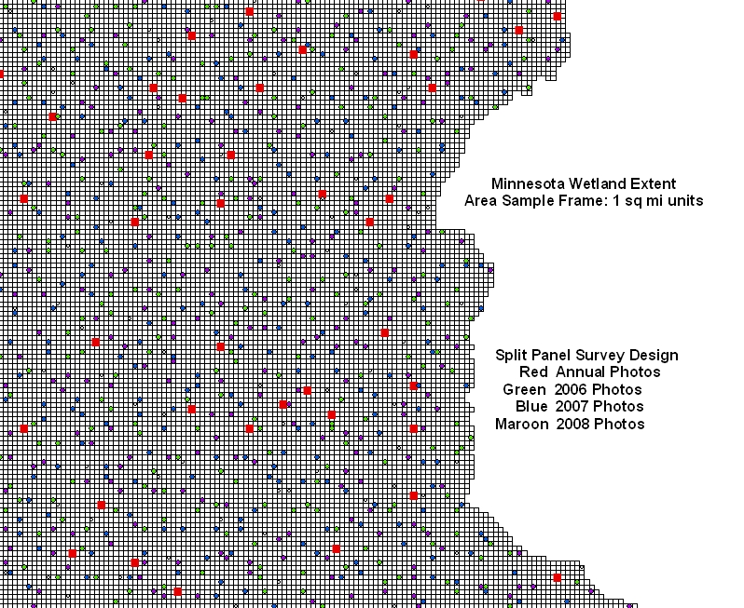

Slide 35
